Slide 1
Memory Management No Memory Abstraction

Slide 2
Review
Process Model
Pseudo-parallelism (Multi-programming, quantum or time slice)
Context Switch (user mode ↔ kernel mode, switch CPU to other process – load/store PCB)
Scheduling algorithm
Batch
FCFS: non-preemptive, process enters ready state first, it will get CPU first, event occurs when the process is terminal state, convey effect
SJF: non-preemptive, the scheduler picks the shorted job first, event occurs when the process is terminal state, optimal algorithms but it not realism
SRT: preemptive, the scheduler chooses the process whose remaining runtime is the shortest, event occurs when the process is new (priority) or terminal
Interactive
RR: preemptive, A process can hold the CPU for a maximum of quantum, event occurs when the process is process ending quantum or terminal, FCFS or context switch
Priority Scheduling: 4 class 1 – 4 that use any scheduling with statically or dynamic priority, the greatest priority runnable process is always run, starvation (aging)
SPT: non-preemptive, estimate the next value in a series by taking the weighted average of the current measured value and the previous estimate then applying to SJF
Multiple Queues, Guaranteed Scheduling, Lottery Scheduling, Fair-Share Scheduling
Real time: meeting deadline

Slide 3
Review
PCB
Id, registers, scheduling information, memory management information, accounting information, I/O status information, …
State (New, Running, Ready, Blocked, Terminal)
CPU Utilization
Shows the CPU utilization
1 – p^{n}
Threads
Share the same address space and resources of the process
Each thread has its own PC, registers and stack of execution
There is no protection between threads in one process
Have its own stack
Improve context switch among processes, optimize quantum
Are implemented in 3 modes: user, kernel, hybrid
Scheduling: same as process in 3 modes combination

Slide 4
Review
IPC
Resolving
Race condition (Critical Region)
Busy waiting (Priority Inversion)
Good solution for race condition
Software: Peterson solution (2 control variables)
Hardware: TSL (atomically, individual)
Good solution for race condition and busy waiting
Software: binary semaphore (recommending about order in using), monitors
Hardware: mutexes
With multiple process
Dinning Philosopher problems: starvation, deadlock → array of semaphore
Baber shop problem
Readers and Writer problems:
No reader will be kept waiting
Only writer can be written

Slide 5
Review
Scheduling
Scheduler component
Event: creation, termination, blocking, Interrupt
Type: non-preemptive, preemptive
Criteria
Fairness, Policy enforcement, Throughput, Turnaround time, CPU utilization, Response time, Proportionality
Turnaround time: terminal time – ready time
Waiting time: ∑ (running time – ready/blocked time)
Process
State (New, Running, Ready, Blocked, Terminal)
Behavior (Compute-bound, I/O-bound)
Address Spaces
The abstraction that is referenced to the set of addresses a process (The address of process is always calculated from 0)

Slide 6
Objectives
Overview
No Memory Abstraction
Simplest
Multiple programming

Slide 7
Overview
The need for a memory to be
infinitely large
infinitely fast
nonvolatile
Types of memory hierarchy
A few MBs/GBs, very fast and expensive, volatile cache memory
A few GBs, medium-speed, medium-price, volatile main memory (RAM)
A few TBs of slow, cheap, nonvolatile disk storage
Memory Manager
The part of the OS manages (part of) the memory hierarchy
It jobs as
coordinate how the different types of memory are used
keep track of which part of memory are in use and which are not
allocate and release areas of main memory to processes
manage swapping between main memory and disk, when main memory is too small to hold all the processes
Notes:
Ngốn dung lượng bộ nhớ lớn => Sinh ra địa chỉ,bộ nhớ ảo

Slide 8
No Memory Abstractions
Simplest
Is no abstraction at all
Mainframe computer (before 1960), early minicomputers (before 1970), and early PC (before 1980)
No swapping or paging
Run only one program at a time
In memory are loaded
the only program that is run the OS
Way of memory organization
OS at the bottom of memory and the user program above
OS at the top of memory (ROM) and the user program bellow
OS at the bottom of memory, device drivers in ROM (mapped at the top of memory – BIOS) and the user program between them

Slide 9
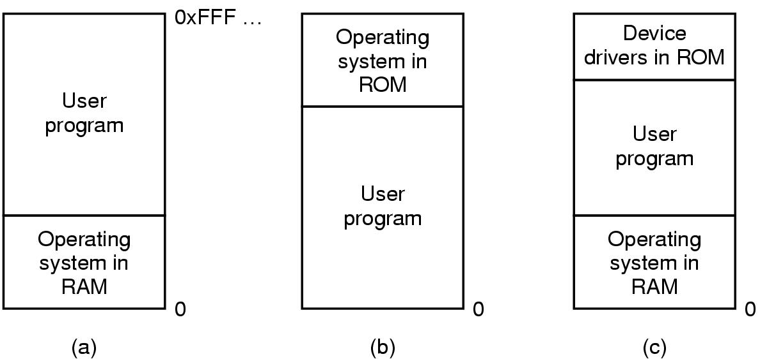
No Memory Abstractions Simplest
Tanenbaum, Fig. 3-1.
Locate at bottom in RAM
Mainframes, minicomputer
Locate at top in ROM
Handheld, embedded
Locate at bottom in RAM, device drives locate at top in ROM
PC
Notes:
b) Dạng nhúng

Slide 10
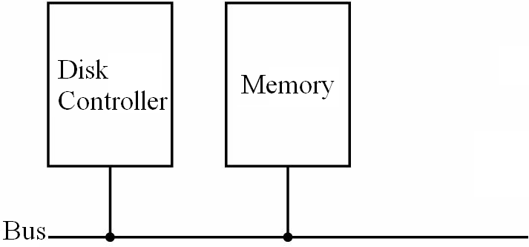
No Memory Abstractions
Simplest
Protection is needed
Solution
Using the special register stores the highest address of OS (in the other words, the address is less than the lowest address of user program)
In runtime, the accessing must be checking via the special register.
If the accessing address is larger than the special register values, the access is accepted
Otherwise, the interrupt occurs to intercept
Disadvantages
The special register is created
Slow
Special Register stores limit addr
True
Real address
>
False
Real address
Address error; trap/ interrupt
Notes:
Real access load lên -> bộ nhớ đầy : (bộ nhớ ko trừu tương: Abstraction )

Slide 11
No Memory Abstractions
Multiple Programs
It is possible to run multiple programs at the same time
The OS saves the entire contents of memory to a disk file, the bring in and run the next program
Solution
Memory was divided into fixed size block and each one was assigned a fixed bit protection key held in special registers inside the CPU
Protect the code of OS against the processes
Protect one process against other processes
Problem:
Internal fragmentation.
After the programs are loaded to run, the two programs both reference absolute physical memory → we want each program to reference a private set of addresses local to it. Number of programs are limited.

Slide 12
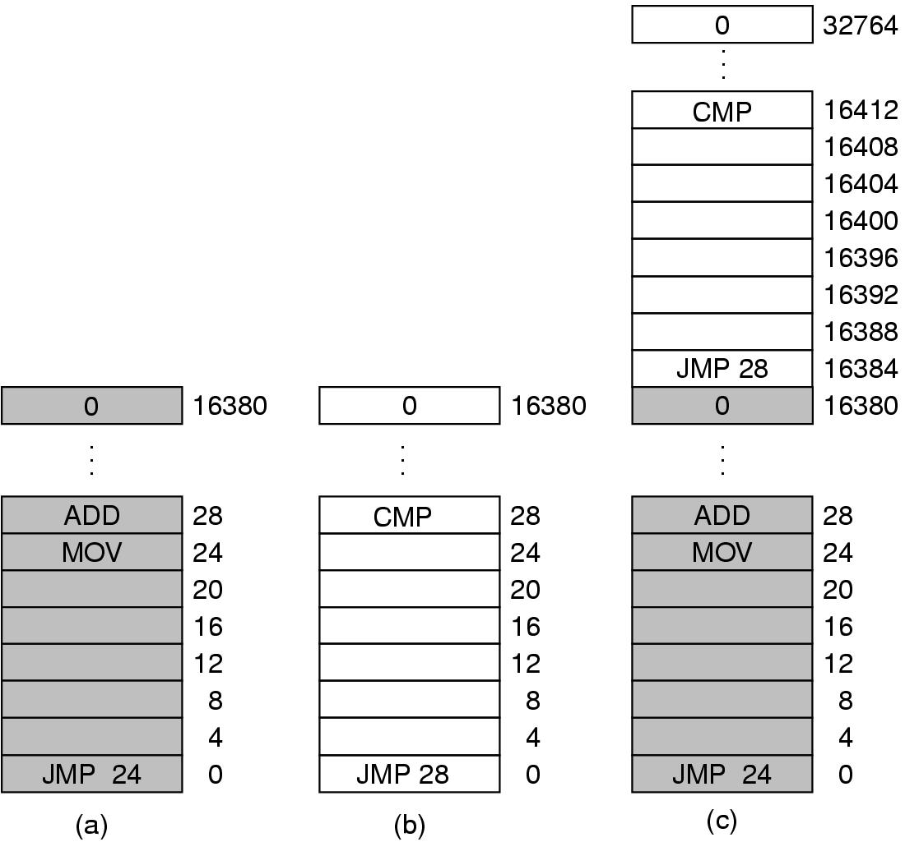
No Memory Abstractions
Multiple Programs
Tanenbaum, Fig. 3-2.

Slide 13
No Memory Abstractions
Multiple Programs
Solution
Static relocation technique
At the compile time, the address of program is a relative addresses.
At the time when the program is loaded into the memory at address n, the constant n was added to every program address during the load process
→ After loaded, the process cannot change its location in memory (static address)
→ Slow down loading
→ Not protection inside process
Loaded address n
Relative address
To load at real added addresses
+

Slide 14
Summary
No Memory Abstraction
Q&A

Slide 15
Next Lecture
A Memory Abstraction

